Slide 1



Red Hat System Security
GTR 1ere Année
RED HAT
SYSTEM SECURITY
01

Slide 2
presentation plan
Red Hat System Security
GTR 1ere Année
FIREWALLd
Securing Services with SELinux
SSH FOR SECURE CONNECTIONS
02

Slide 3
Red Hat System Security
GTR 1ere Année
FIREWALLD
03
PRESENTED BY : OTHMANE EL MQIDDEM

Slide 4
FIREWALL
Red Hat System Security
GTR 1ere Année
A firewall is a network security system that monitors and controls incoming and outgoing network traffic based on predefined rules. It operates at different layers of the network stack and relies on the kernel to enforce these rules. The kernel, being the core of the operating system, intercepts and evaluates data packets against the firewall's rules before they reach the application layer or the network interface, ensuring security
FIREWALLd
Firewalld is a dynamic firewall management tool in RHEL 9 that leverages the kernel's packet-filtering capabilities . It provides an abstraction layer to define zones and apply rules dynamically, without requiring a system restart. The kernel enforces these rules, intercepting and managing packets at the network stack level based on the configurations set by Firewalld. This close interaction with the kernel ensures high performance and system-level control over network traffic.
04

Slide 5
Red Hat System Security
GTR 1ere Année
Securing Services with SELinux
05
PRESENTED BY : MOHAMMED REQASSE & SOUHAYL RAMDANI

Slide 6
Red Hat System Security
GTR 1ere Année
Securing Services with SELinux
What is SELinux?
SELinux (Security Enhanced Linux) is a Linux security framework by the NSA that enforces Mandatory Access Control (MAC) to limit damage from exploits or misconfigurations.
Why SELinux is Important?
Adds an additional layer of security.
Limits damage caused by misconfigurations or compromised applications.
Mitigates zero-day vulnerabilities.
Key Features
Mandatory Access Control (MAC): Restricts access based on security policies.
Modes: Enforcing (active), Permissive (logs), or Disabled.
Context-Based Security: Labels control file, process, and port access.
06

Slide 7
Red Hat System Security
GTR 1ere Année
Securing Services with SELinux
Practical Use Cases
Web Server Isolation: Restrict a web server to access only required files.
Secure Containers: Enforcing security for containerized environments.
Compliance: Meeting regulatory security requirements.
Components of SELinux
Security Policies: Rules defining access permissions.
Contexts: Labels applied to files, processes, and ports.
Tools: setenforce, getenforce, semanage, restorecon.
Summary
SELinux enforces strict security policies using Mandatory Access Control (MAC).
It limits access to files, processes, and ports to reduce risks from attacks.
Operates in Enforcing, Permissive, or Disabled modes for flexibility.
01

Slide 8
Red Hat System Security
GTR 1ere Année
SSH FOR SECURE CONNECTIONS
08
PRESENTED BY : HAYTHAM

Slide 9
Red Hat System Security
GTR 1ere Année
SSH (Secure Shell)
What is SSH?
SSH (Secure Shell) is a protocol for secure remote login and command execution. Use cases: Secure access to servers, remote administration, file transfers, tunneling, and more.
Why SSH Matters?
Ensures confidentiality, integrity, and authentication over untrusted networks.
Use cases: Secure access to servers, remote administration, file transfers, tunneling, and more
How SSH Works?
Client-Server Model: The client initiates the connection, and the server listens on TCP port 22.
Authentication Methods: Supports passwords, key pairs, and advanced methods like Kerberos or certificates.
01

Slide 10

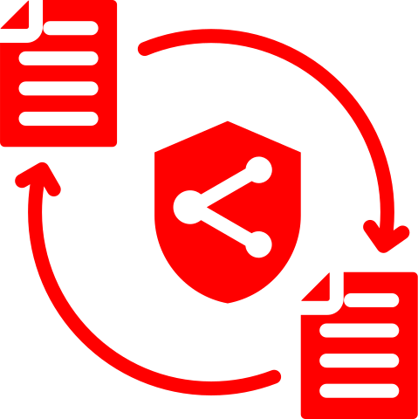

Red Hat System Security
GTR 1ere Année
SSH Features
Remote Login
Securely connect to a remote machine.
File Transfer
Tools like scp and rsync over SSH.
Automation
SSH keys for password-less login.
Use in scripts for remote task execution.
10

Slide 11
Red Hat System Security
GTR 1ere Année
THANK YOU
For your attention
11

